Slide 1
Giới thiệu về Protocol Oriented Programing

Slide 2
Content
Protocol oriented programming
Protocol
Protocol extensions, inheritance and compositions.
POP vs OOP
Unit
Demo

Slide 3
Protocol Oriented Programming
Apple announced that Swift is the world’s first Protocol-Oriented Programming (POP) language.
Protocol-Oriented Programming is a new programming paradigm ushered in by Swift 2.0.
In the Protocol-Oriented approach, we start designing our system by defining protocols.
New concepts: protocol extensions, protocol inheritance, and protocol compositions.

Slide 4
Protocol Oriented Programming
In Swift, value types are preferred over classes.
Object-oriented concepts don’t work well with structs and enums.
Struct cannot inherit from another struct.
Creating as many protocols and protocol extensions as needed.

Slide 5
Protocol
A set of methods, property and other requirement.
Can be adopt by a class, structure, or enumeration.
Any type that satisfies the requirements of a protocol is said to conform to that protocol.
Familliar with Java’s Interface.
protocol SomeProtocol {
// protocol definition goes here
}

Slide 6
Protocol example
protocol Drink {
//property
var volume: Double {get set}
var sugar: Double {get set}
var temperature: Double {get set}
var drinkSize: DrinkSize {get set}
// method
func drinking(amount: Double)
}

Slide 7
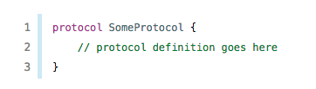
Protocol Syntax
A protocol can have properties as well as methods that a class, enum or struct conforming to this protocol can implement.
A protocol declaration only specifies the required property name and type. It doesn’t say anything about whether the property should be a stored one or a computed one.
A protocol also specifies whether each property must be gettable or gettable and settable.
Property requirements are always declared as variable properties, prefixed with the var keyword.
Gettable and settable properties are indicated by writing { get set } after their type declaration, and gettable properties are indicated by writing { get }

Slide 8
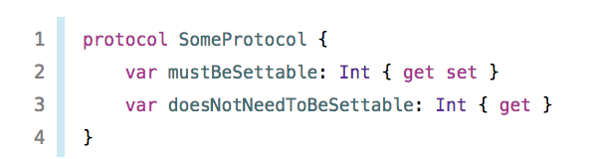
Protocol Syntax
Methods is the same.
without curly braces or a method body.
class or static

Slide 9
Protocols as Types
As a parameter type or return type in a function, method, or initializer
As the type of a constant, variable, or property
As the type of items in an array, dictionary, or other container
Because protocols are types, begin their names with a capital letter to match the names of other types in Swift.

Slide 10
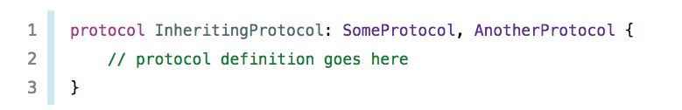
Protocol Inheritance
protocol can inherit one or more other protocols. The syntax of protocol inheritance is similar to class inheritance.

Slide 11
Protocol Composition
Protocol composition allows types to conform to more than one protocol.
This is one of the many advantages that POP has of OOP.
You can combine multiple protocols into a single requirement with a protocol composition.
SomeProtocol & AnotherProtocol

Slide 12
Checking for Protocol Conformance
You can use the is and as operators described in Type Casting to check for protocol conformance, and to cast to a specific protocol.
The is operator returns true if an instance conforms to a protocol and returns false if it does not.
if let animal = animal as? AirAnimal {
print("Animal at \(index) is Air")
}

Slide 13
Protocol Extensions
one of the most important parts of the protocol-oriented programming paradigm.
They allow us to add functionality to all types that conform to a given protocol.
Without extension no pop.

Slide 14
Protocol Extensions
extension JSONResource {
// Default host value for REST resources
var jsonHost: String {
return "itunes.apple.com"
}
// Generate the fully qualified URL
var jsonURL: String {
return String(format: "https://%@%@", self.jsonHost, self.jsonPath)
}
}

Slide 15
Protocol Extension Limitations
Cannot store dynamic variables inside a protocol extension.
Cannot adopt multiple protocol extensions with duplicate members.
For example, if we have 2 protocol extensions which implement the same methods, only the last one we've adopted will be used when the method is invoked.

Slide 16
Adding Constraints to Protocol Extensions
When you define a protocol extension, you can specify constraints that conforming types must satisfy before the methods and properties of the extension are available. You write these constraints after the name of the protocol you’re extending using a generic where clause.

Slide 17
extension MediaResource where Self: Album {
var mediaURL: String {
return self.albumUrlImage ?? ""
}
var imageValue: UIImage? {
if let imageData = self.dataForURL(url: self.mediaURL) {
return UIImage(data: imageData as Data)
}
return nil
}
func loadMedia(completion: (() -> ())?) {
load(url: self.mediaURL) { success in
if let completion = completion {
DispatchQueue.main.async(execute: completion)
}
}
}
}

Slide 18
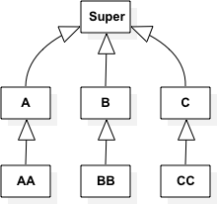
Object Oriented Programming
start with a superclass
model its relationships through inheritance

Slide 19
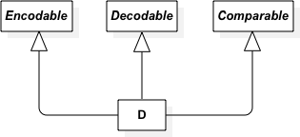
Protocol Oriented Programming
serve as blueprints rather than parents
separate the concerns by creating as many protocols and protocol extensions as needed.

Slide 20
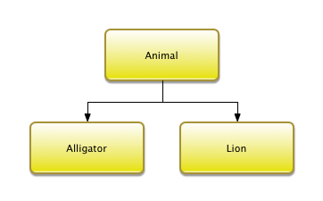
Object-Oriented Design

Slide 21
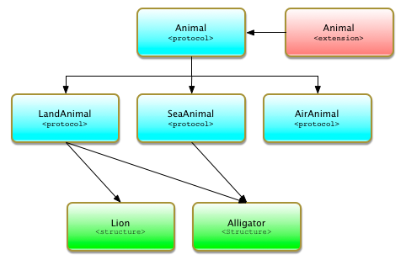
Protocol-Oriented Design

Slide 22
POP vs OOP
Pros:
POP works with all Swift types. Including value types, which are preferred over classes.
Why should we love value types you may ask. Mostly because they don't automatically share mutable state.
Implement multiple protocols, multiple abstractions -> huge benefit over class inheritance.
Cons:
provide a complete brand new implementation
Cannot store dynamic variables inside a protocol extension.

Slide 23
Unit test
protocol FoodService {
func cook()
func makeFood()
}
extension FoodService {
func cook() {
makeFood()
}
func makeFood() {
print("Makeing food...")
}
}

Slide 24
Unit test
class MockFoodService: FoodService {
var foodWasCook = false
func makeFood() {
foodWasCook = true
}
}
func testFoodService() {
let mockFoodService = MockFoodService()
mockFoodService.cook()
XCTAssertTrue(mockFoodService.foodWasCook)
}

